Slide 1
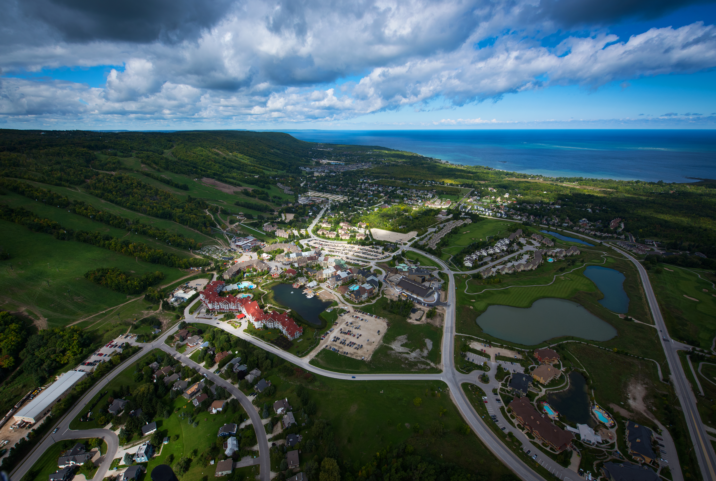


Slide 2
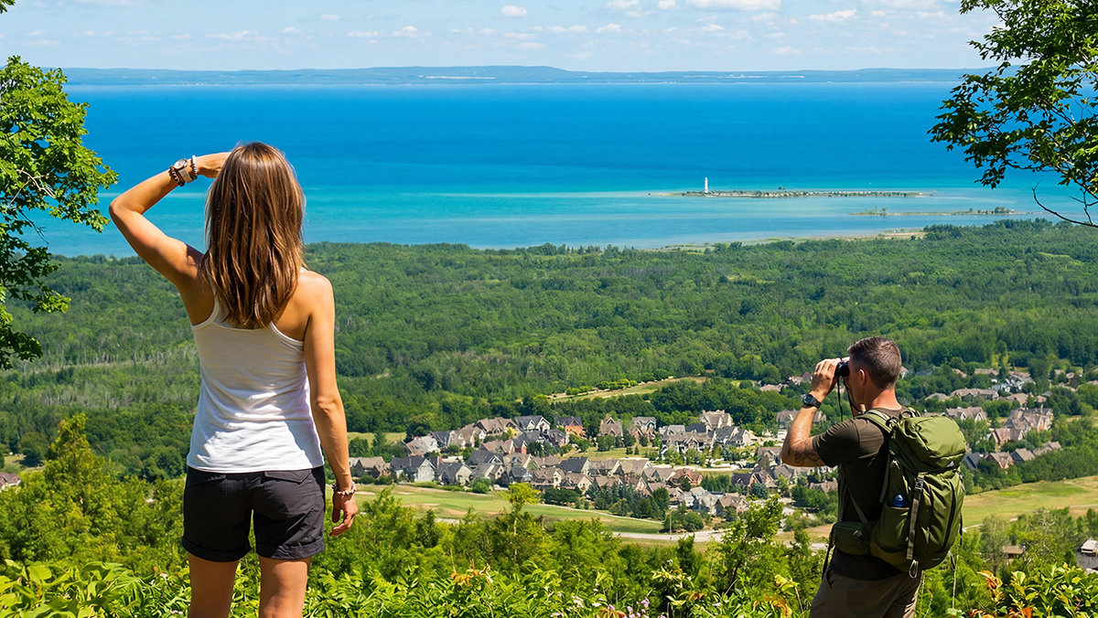
Step into year-round outdoor adventure in The Blue Mountains, where each season brings the landscape to life. Explore scenic trails, unwind along the shores of Georgian Bay, and discover a mix of outdoor activities, small town charm, local flavours, and lakeside moments. Whether you’re after active days or relaxed afternoons, every visit offers something new to experience at your own pace.

Slide 3
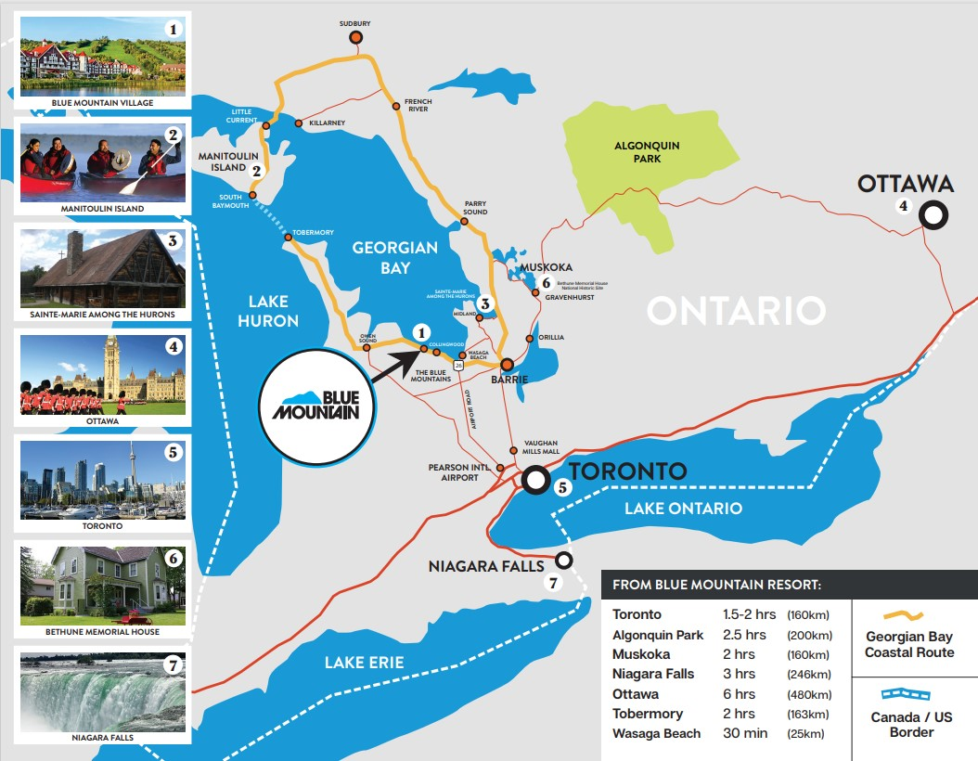

In The
Heart of
Ontario
TORONTO 1.5 - 2hours (160 km)
NIAGARA FALLS 3 hours (246 km)
OTTAWA 2 hours (480 km)

Slide 4
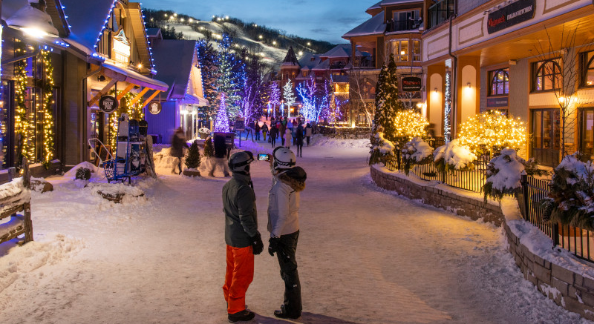
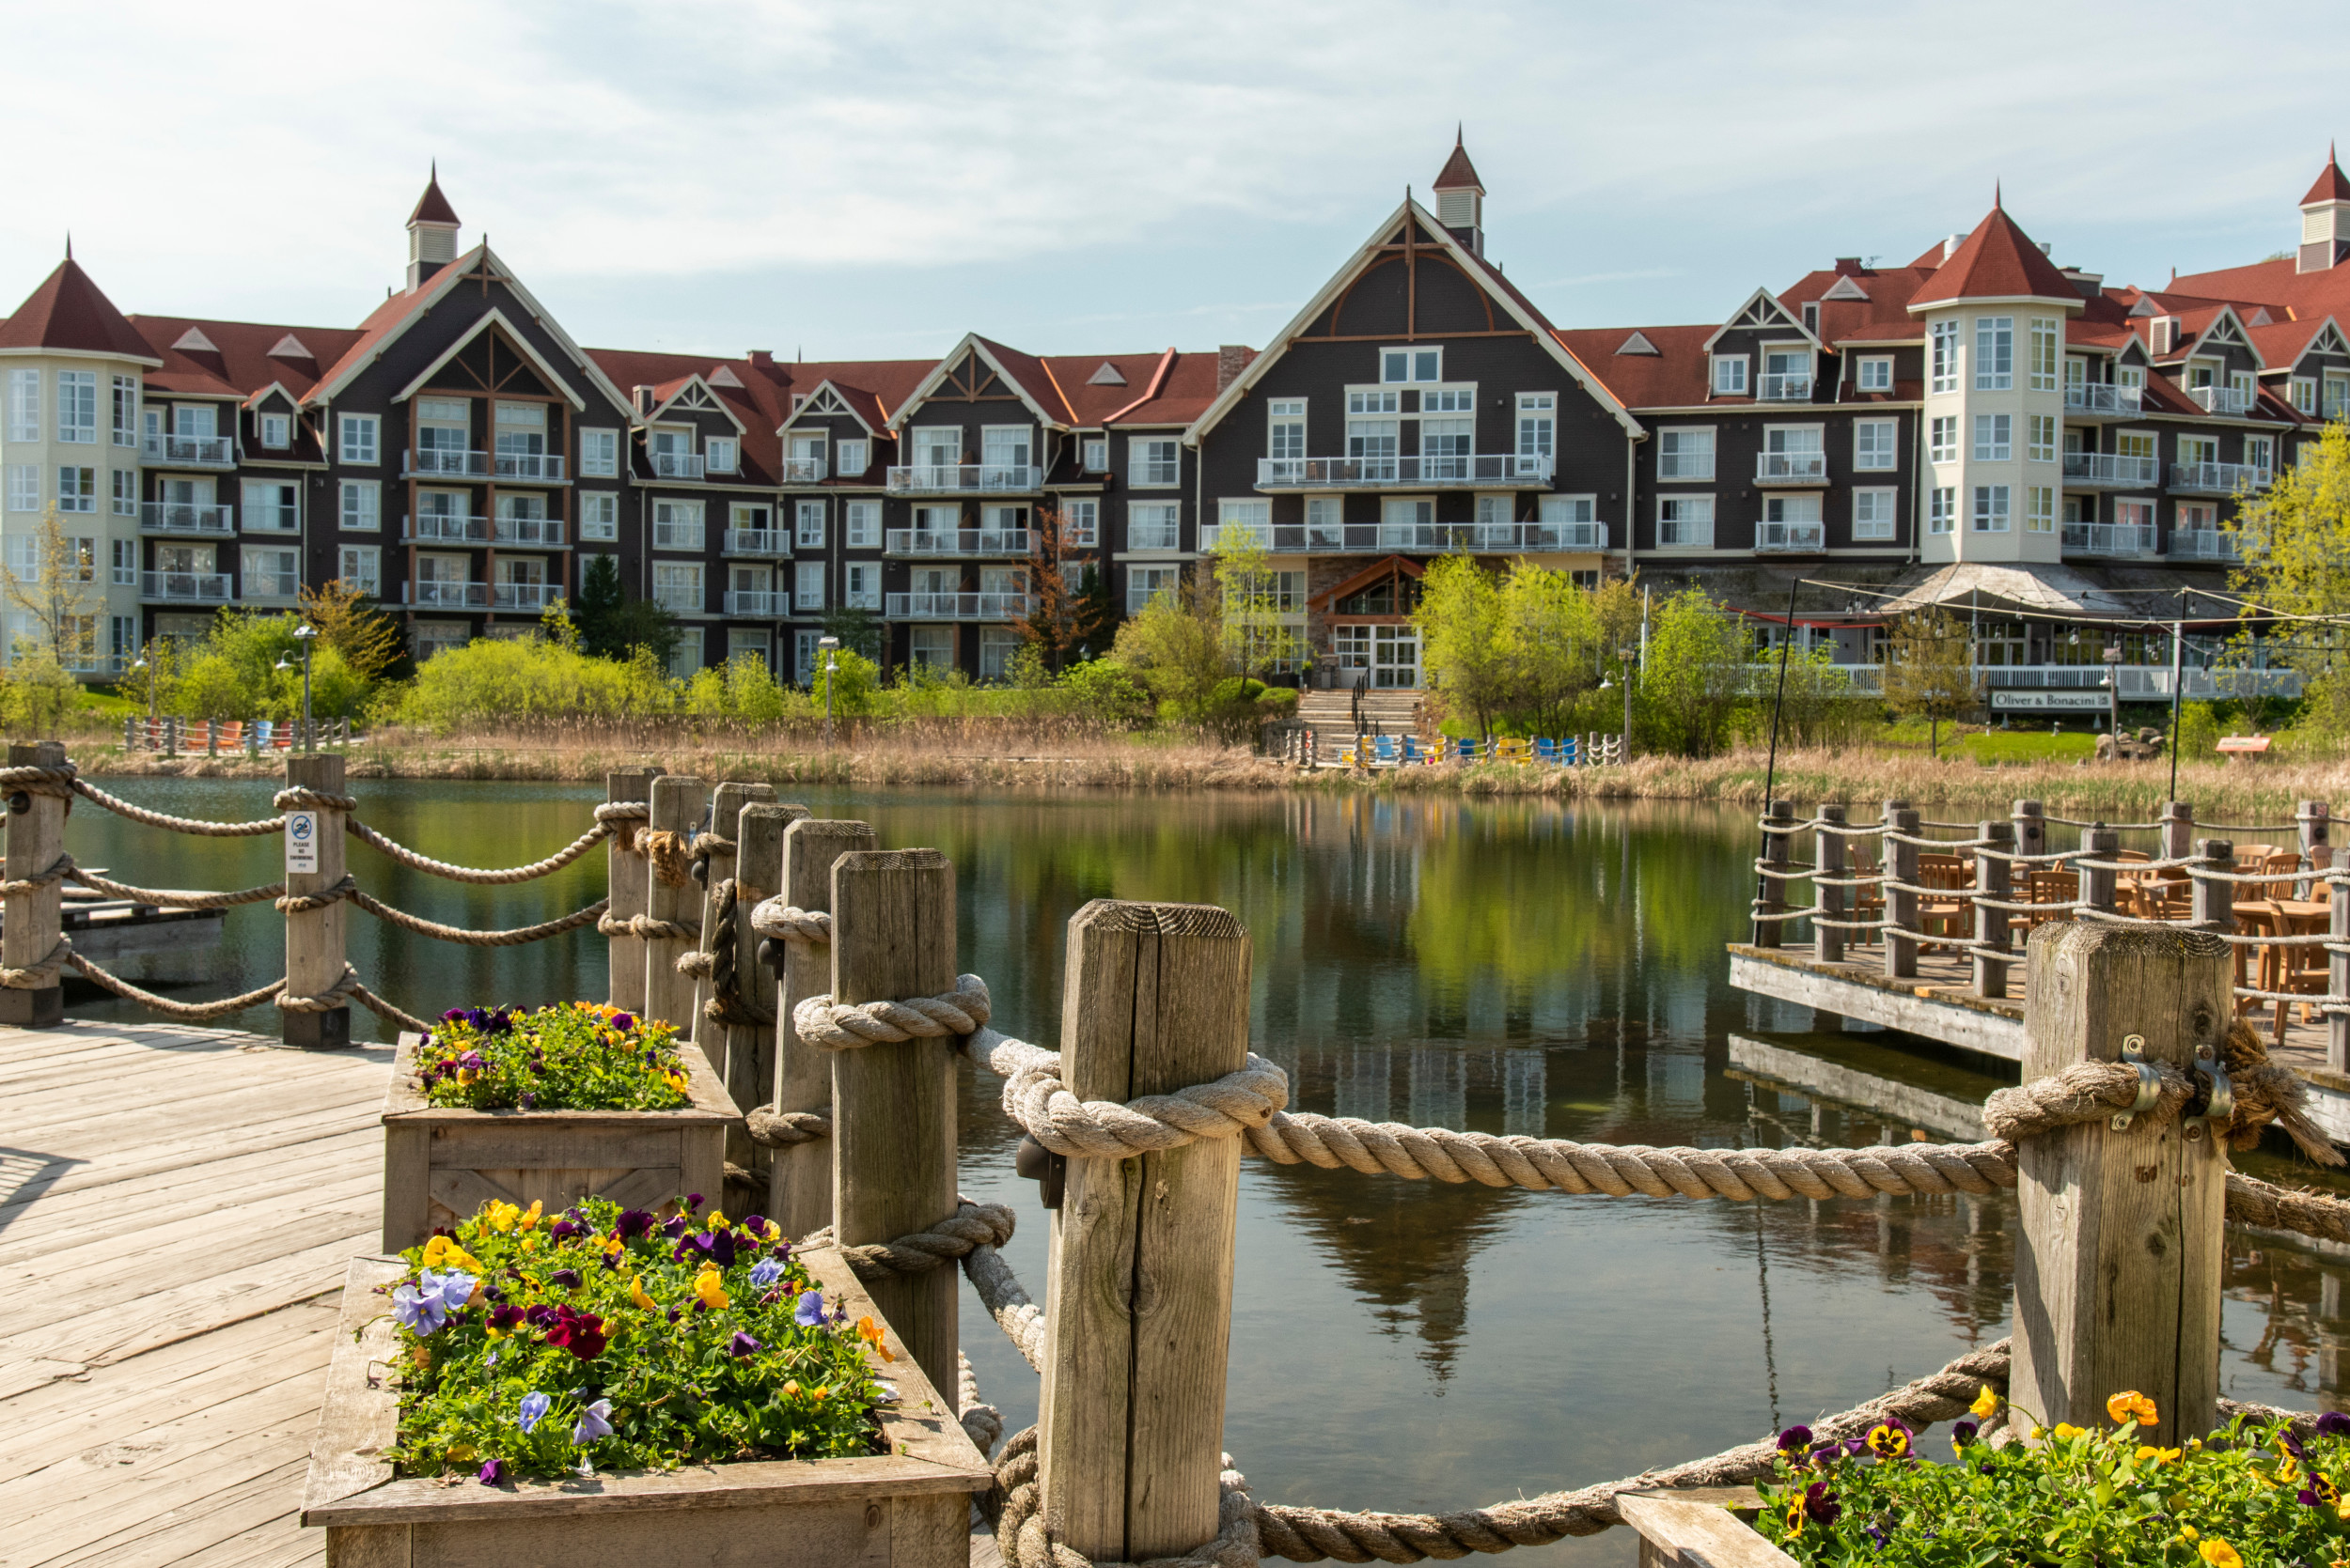
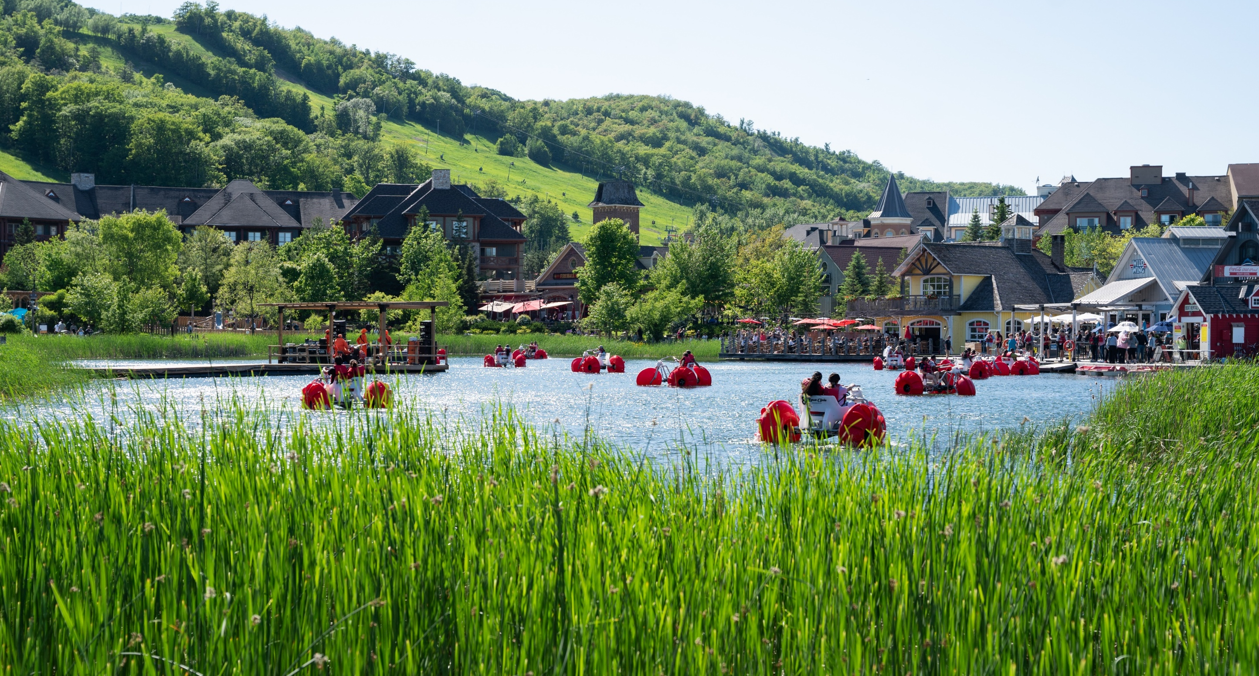
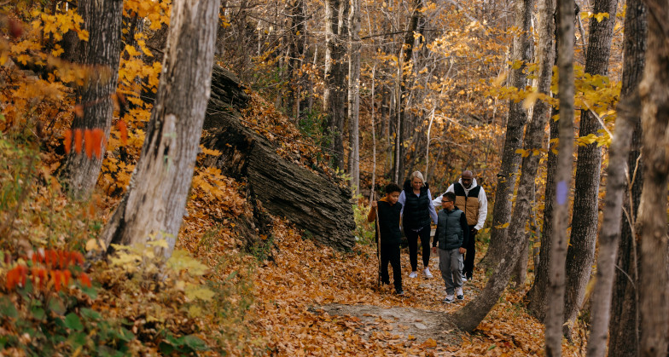

Slide 5
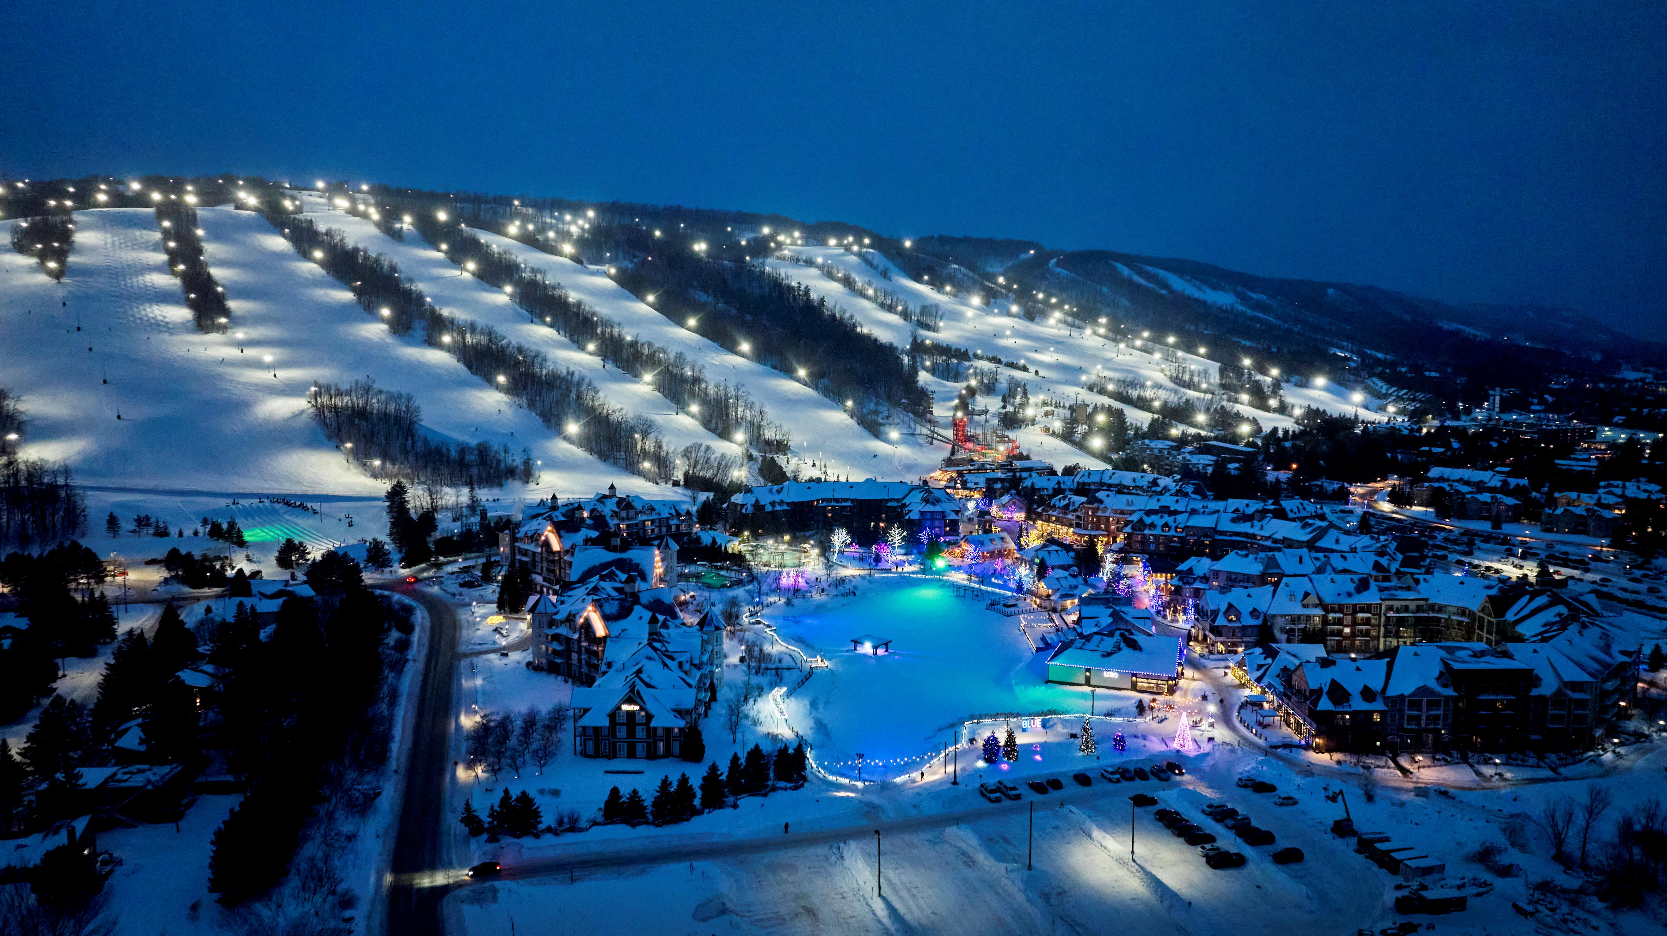
Blue Mountain Resort is Ontario’s largest year-round mountain village resort. It is uniquely situated between the shores of Georgian Bay
and the slopes of the Niagara Escarpment,
a UNESCO World Biosphere Reserve.

Slide 6
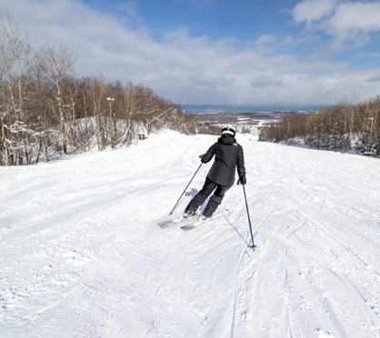
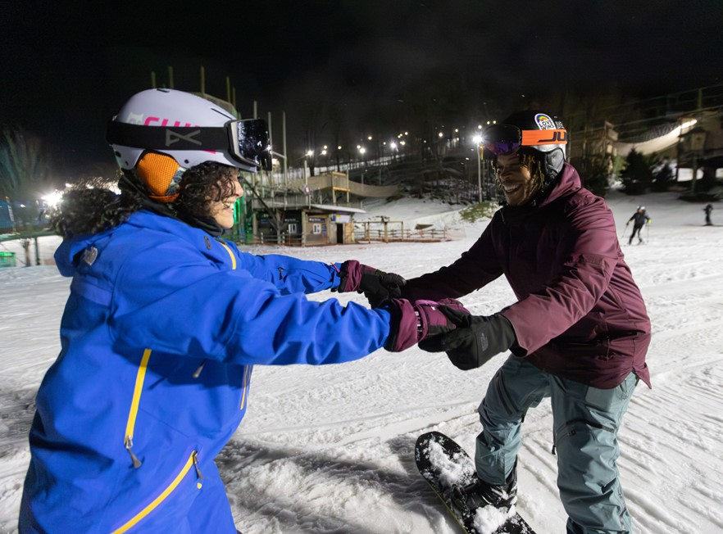
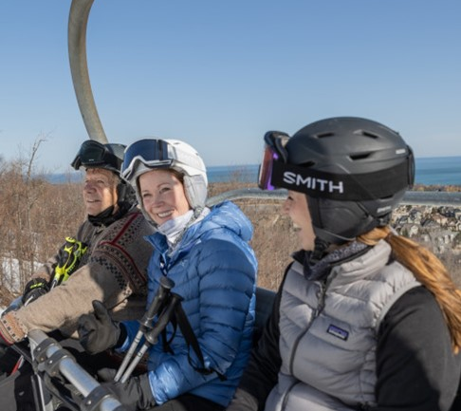
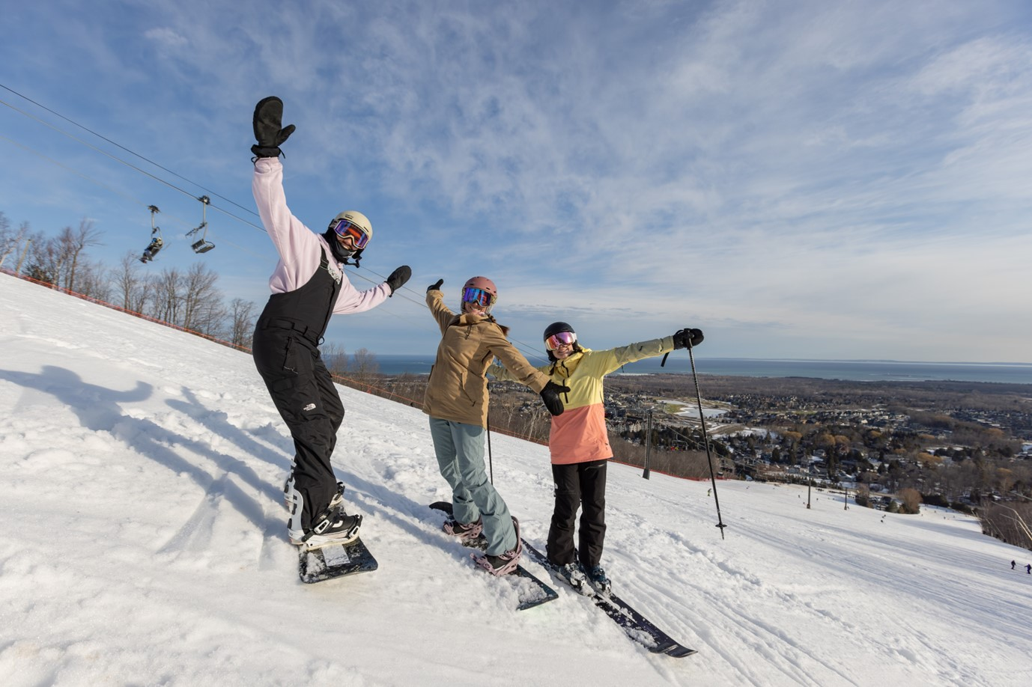
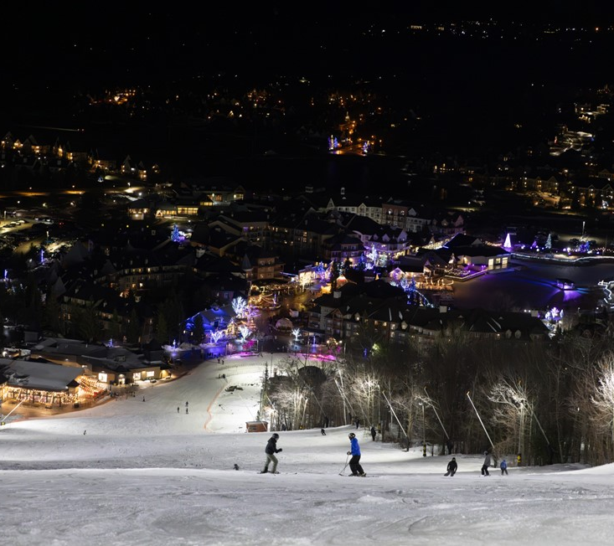


Winter at Blue Mountain Resort
Mid-December to April
SKIING & SNOWBOARDING:
    365 Acres of Skiable Terrain
43 Trails, 30 Open for Night Skiing
720 Vertical Feet
7 Chairlifts
2 Beginner Centres
Learn to Ski Guarantee!
March is KIDS SKI FREE Month!

Slide 7
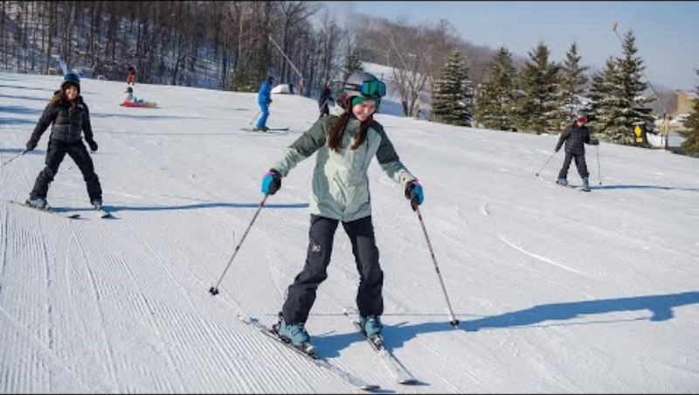

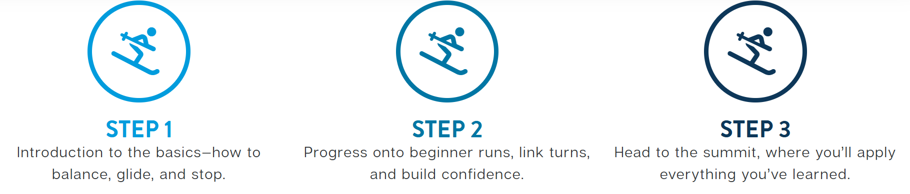

Learn to Ski Guarantee
In just three consecutive lessons, you will gain skills, build confidence, and learn to safely ski or snowboard from the top of the mountain to the bottom—guaranteed.*
When you complete all three steps and graduate to the top of the mountain, you will receive a FREE 5x7® season pass* for the 26/27 ski season!

Slide 8
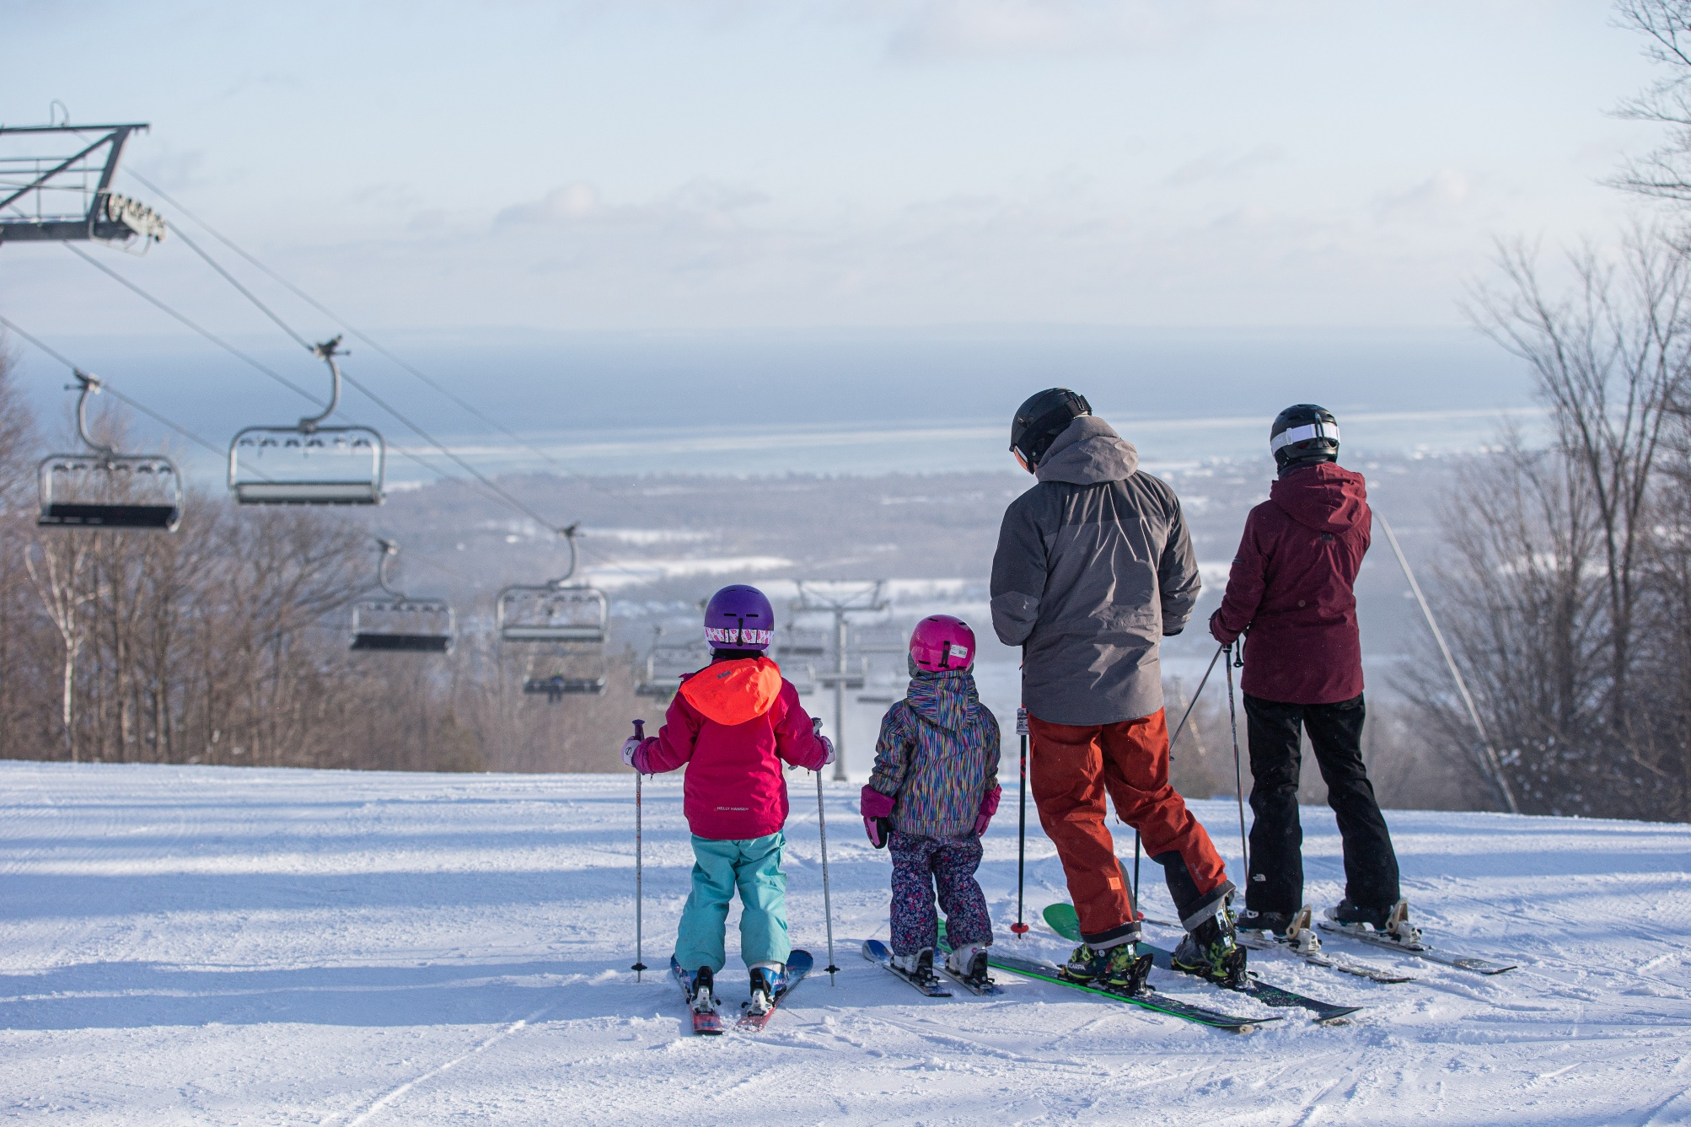
NEW! All-Inclusive Ski Weeks
Everything you need for a memorable ski getaway. Create a new winter tradition with an all-inclusive ski week at Blue Mountain Resort.
Your package includes:
Resort accommodation Monday to Thursday evenings.
Daily breakfast, lunch and dinner
Lift tickets
Daily ski or snowboard lesson
Rental equipment
Après events
Skating
Snow tubing
And more winter fun!
from $939** USD per adult based on double occupancy in a Village Studio Suite
from $719** USD per child aged 13 - 17
from $529** USD per child aged 7-12
** US price point based on 2 adults in double occupancy room. Representative exchange rate of 0.72. Actual bookings subject to current exchange rates. Offer is subject to applicable taxes and cannot be combined with other offers or group bookings.

Slide 9
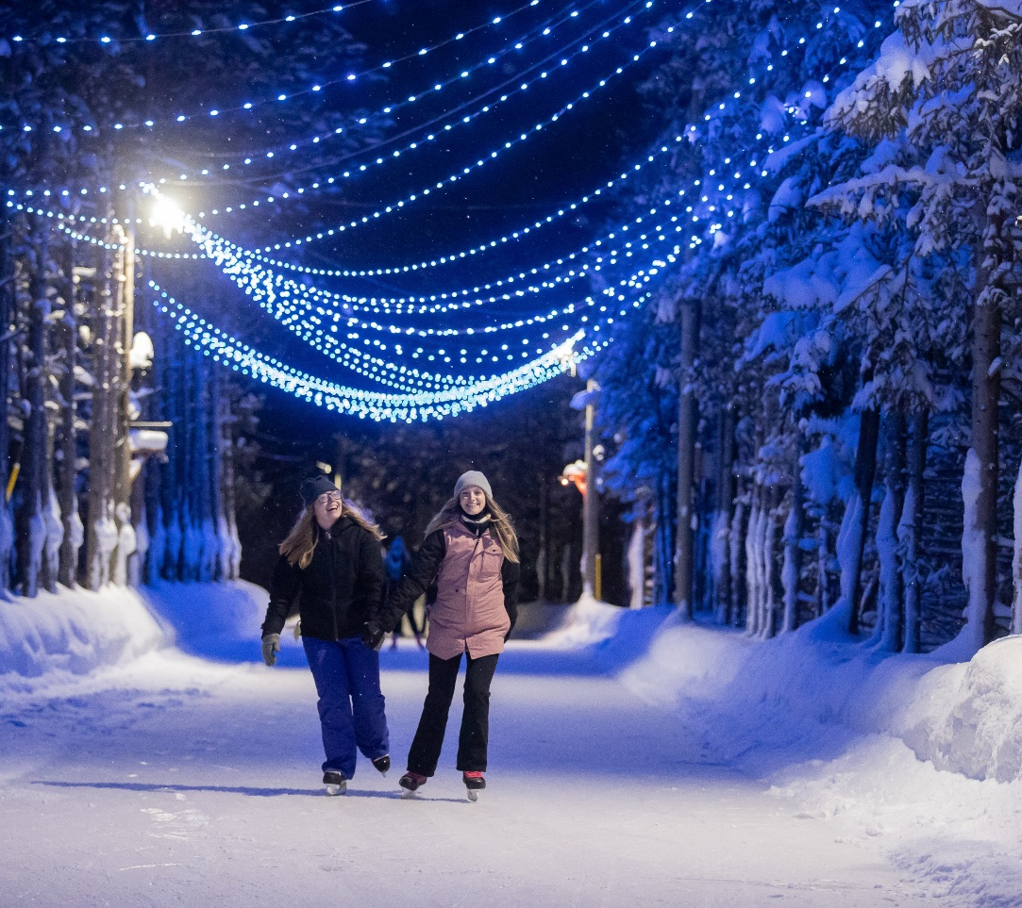
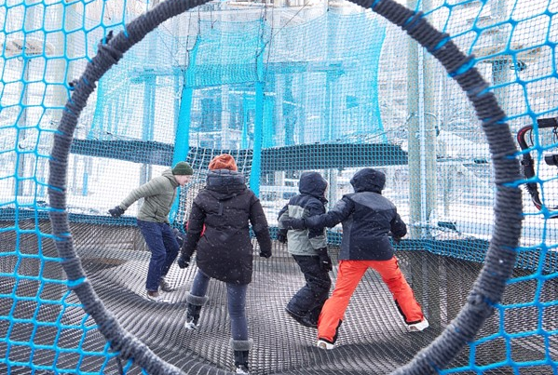
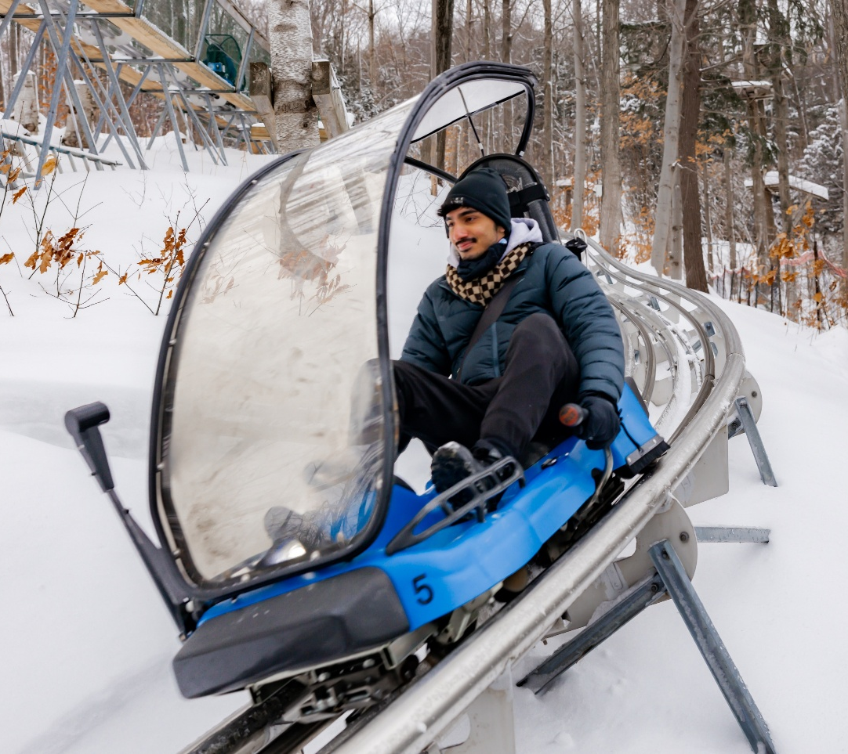
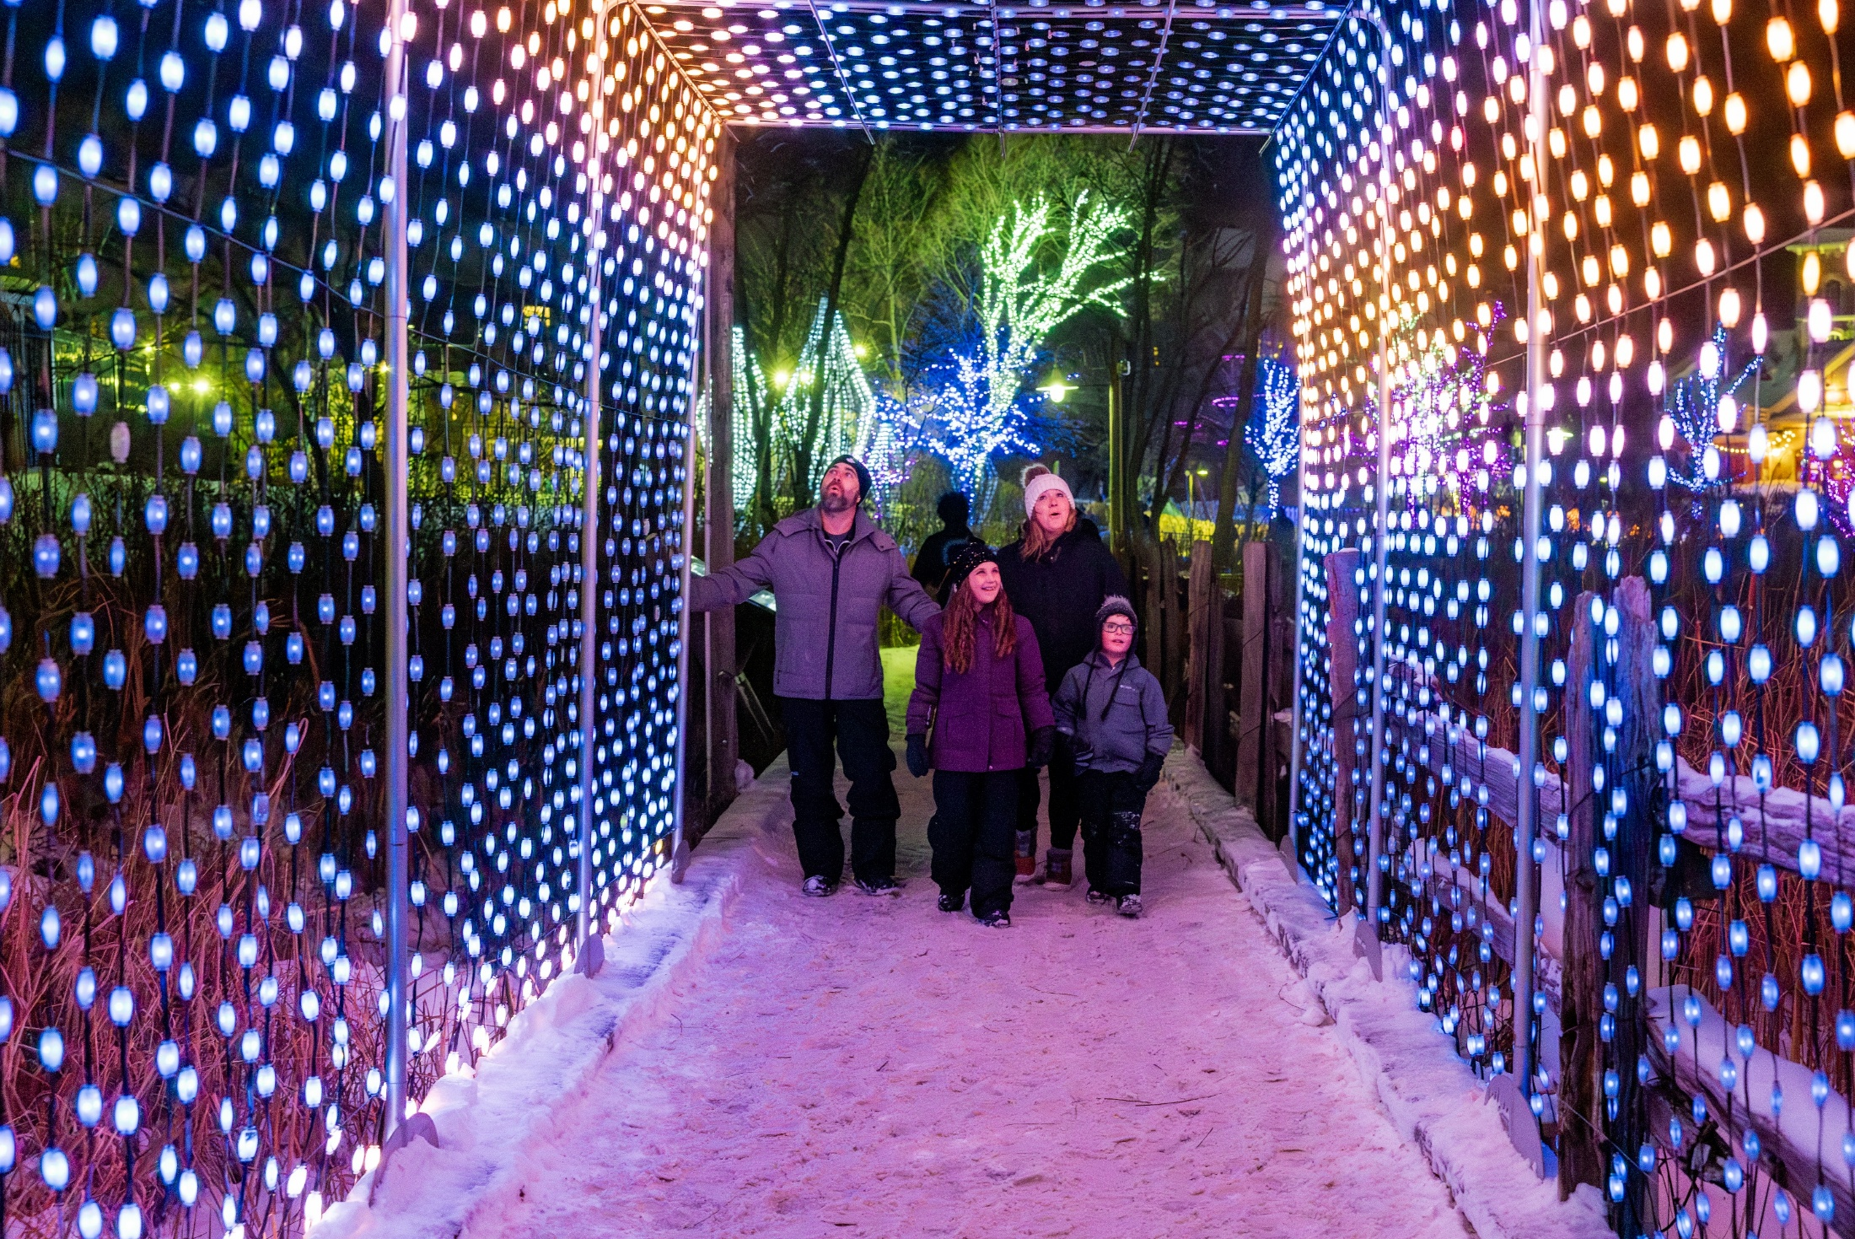
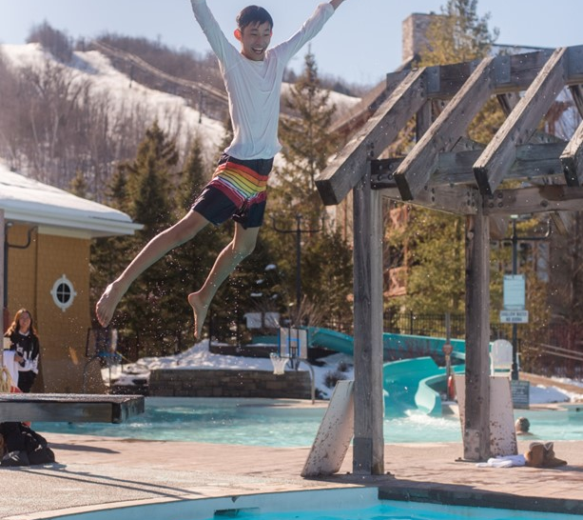
Winter at Blue Mountain Resort
Mid-December to April
WINTER ATTRACTIONS:
Snowshoeing
Woodview Mountaintop Skating
Ridge Runner Mountain Coaster
Big Dipper Snow Tubing
Canopy Climb Net Adventures
Plunge! Aquatic Centre
1 km Blue Mountain Village Light Trail
Après Ski with Live Music
Events & Family Activities

Slide 10
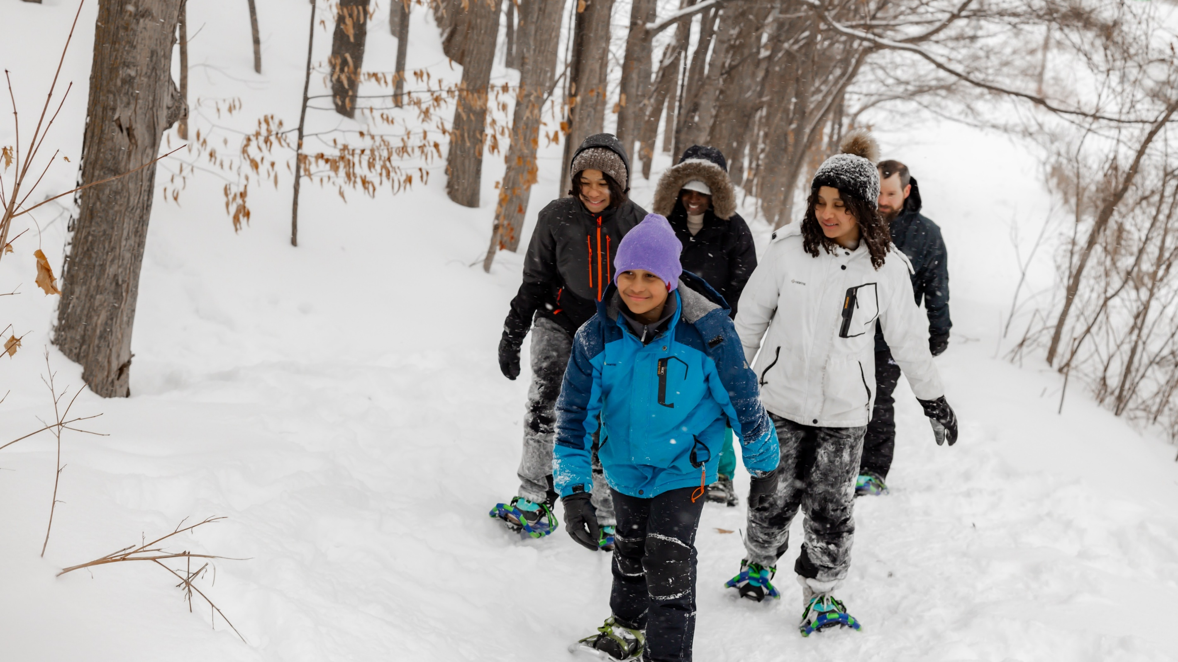
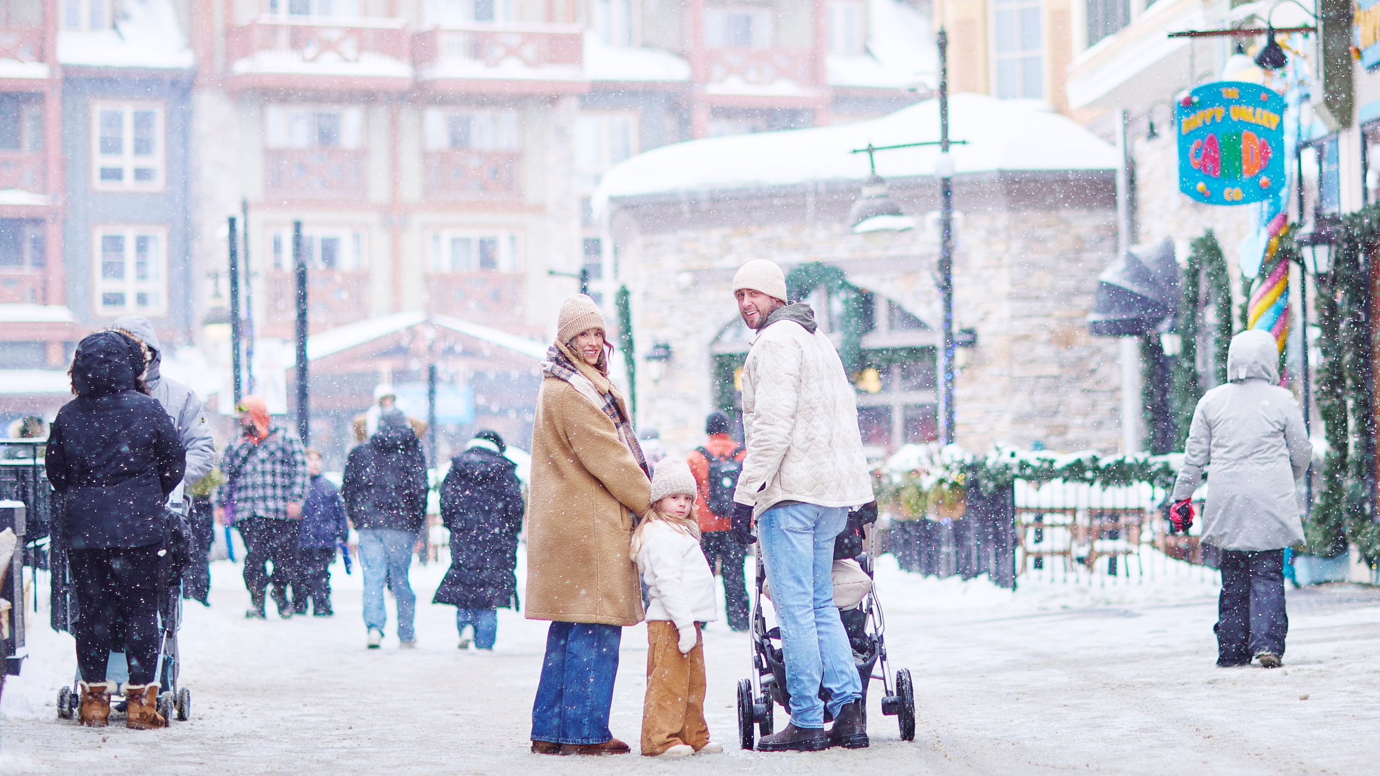
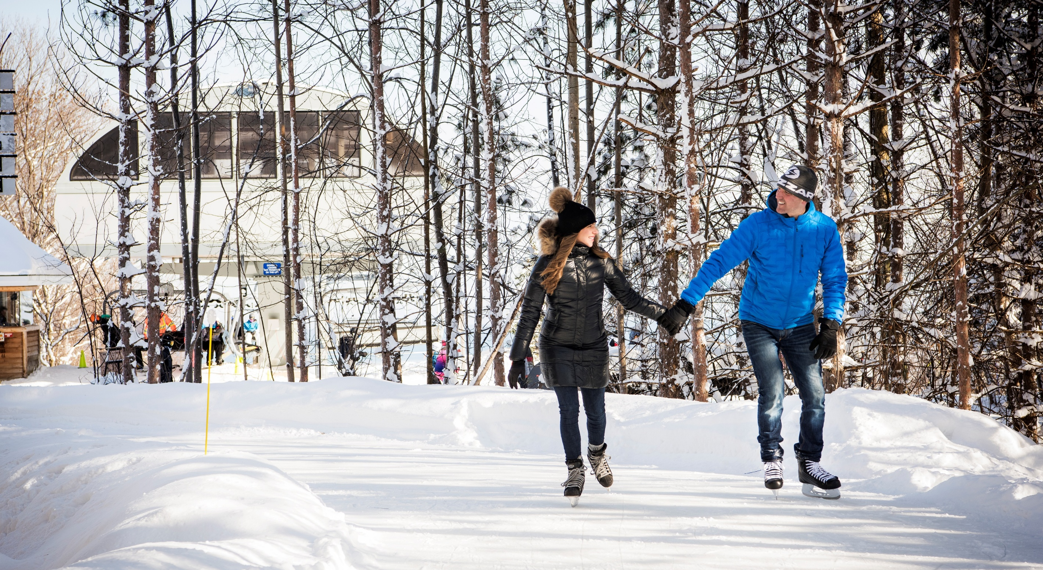
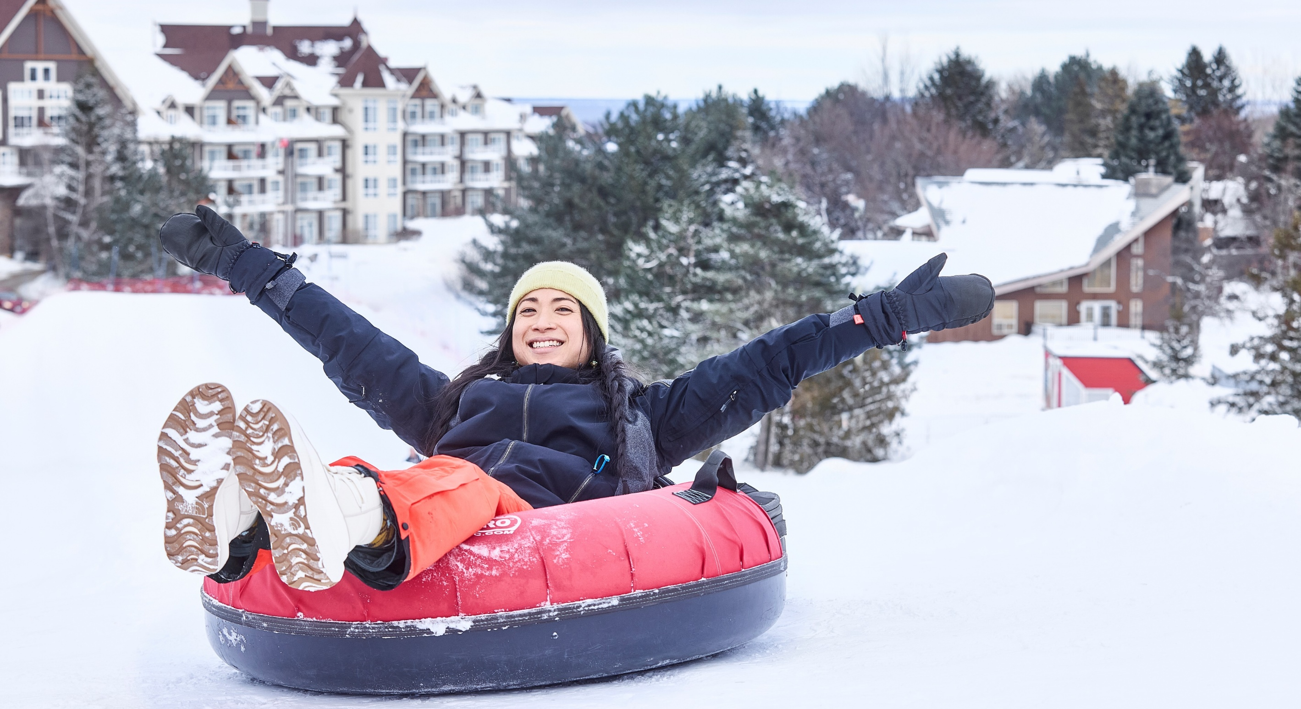

Slide 11
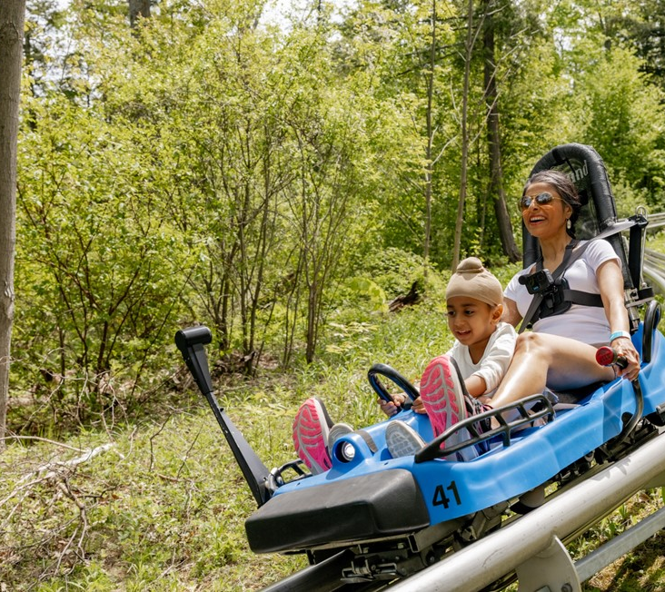
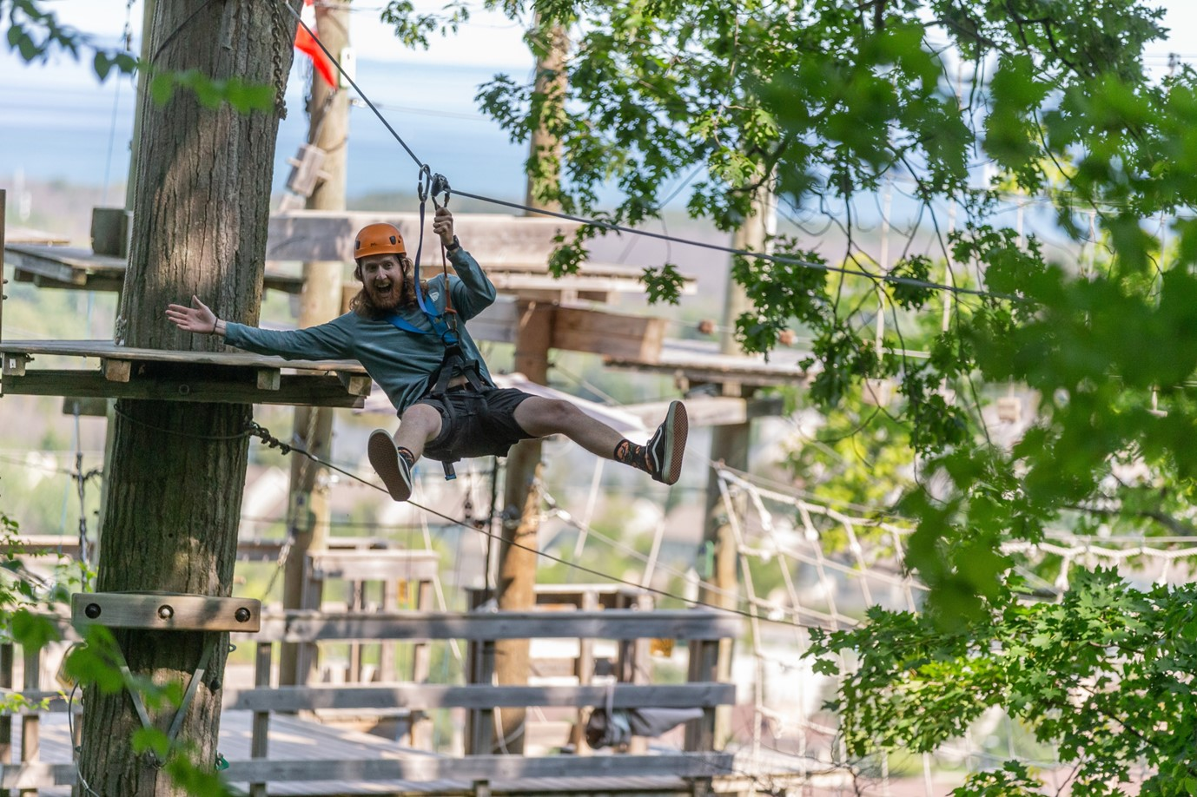
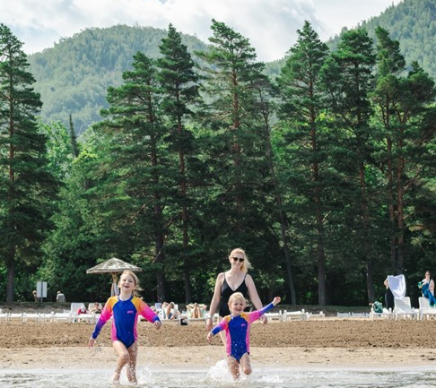
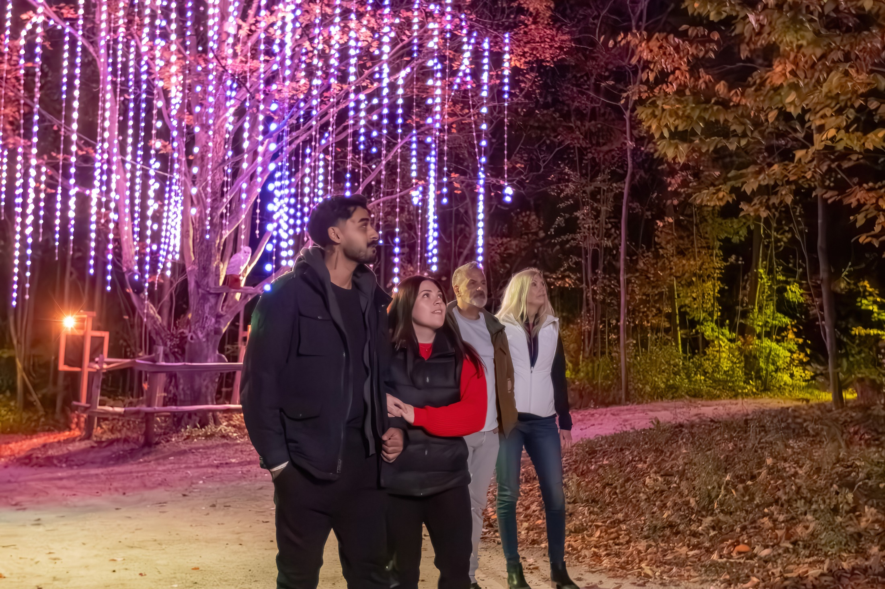
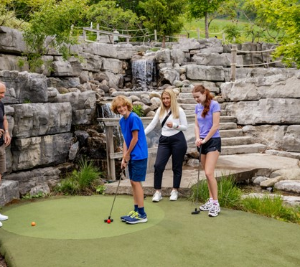
Spring, Summer & Fall
Spring/Summer: Mid-May to the end of August
Fall : September & October
Blue Mountain Private Beach (Summer Only)
Open-Air Gondola
Ridge Runner Mountain Coaster
Canopy Climb Net Adventure
Cocoon Crawl Playscape
Wind Rider Triple Zips
Cascade Putting Course
Lumber Lanes Climbing Centre
Millpond Activity Centre
Timber Challenge High Ropes!
Plunge! Aquatic Centre
Explore Park Hiking/Biking Trails
Monterra Golf
Spa Escapes
Winery, Cidery & Brewery Tours
Agora: Path of Light (Fall Only)

Slide 12
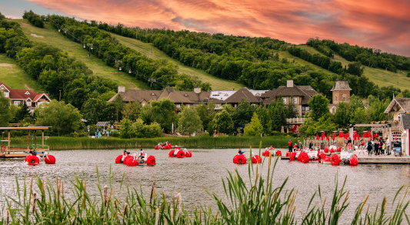
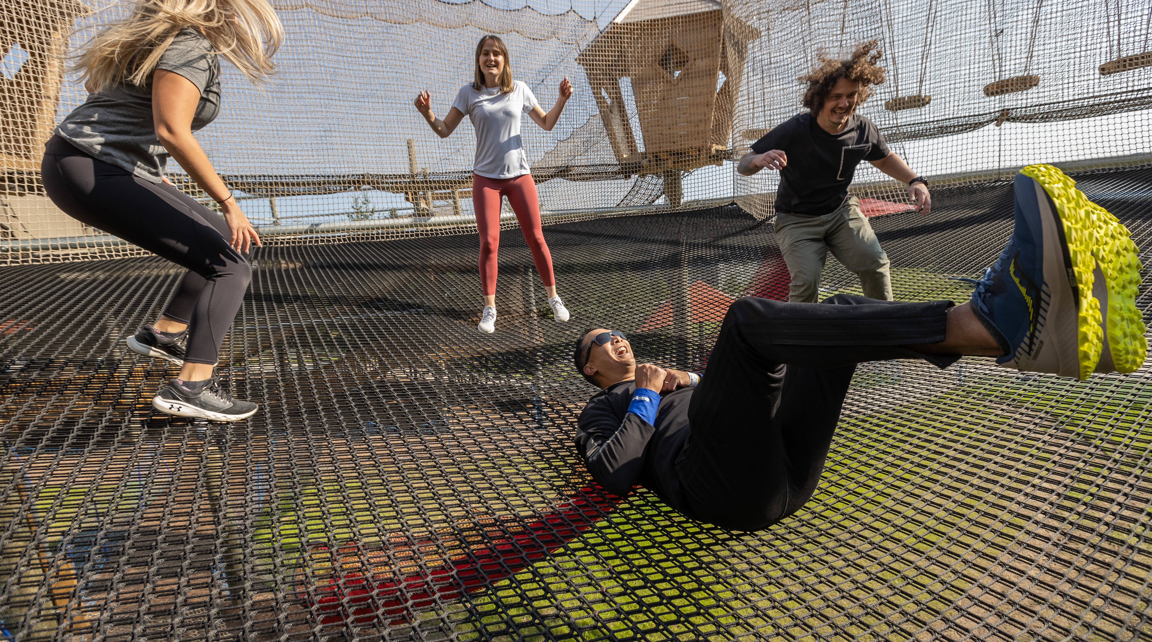
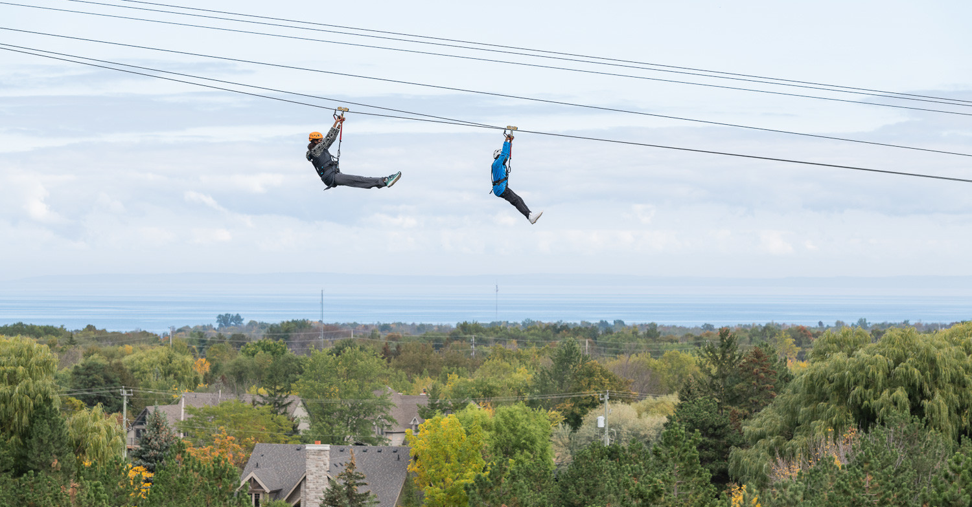
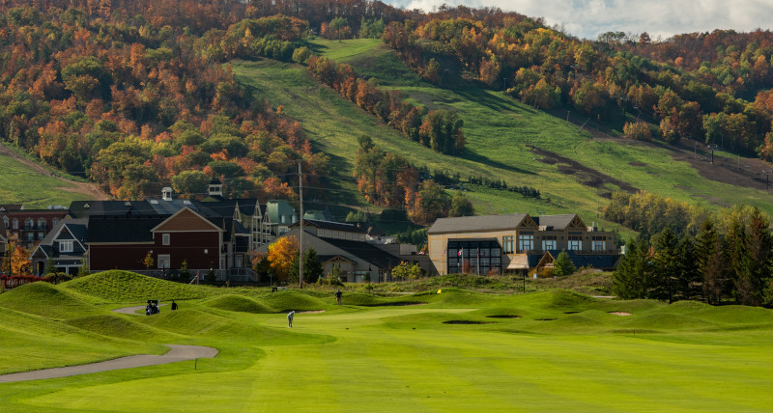

Slide 13
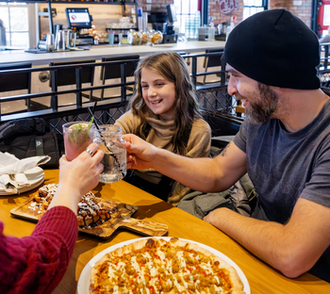
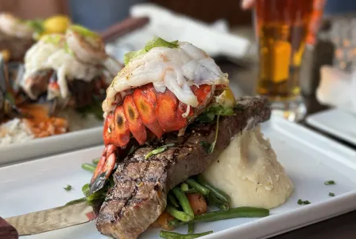
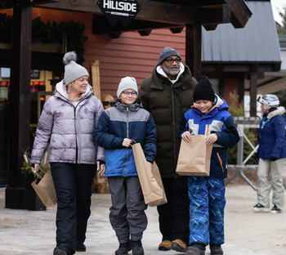
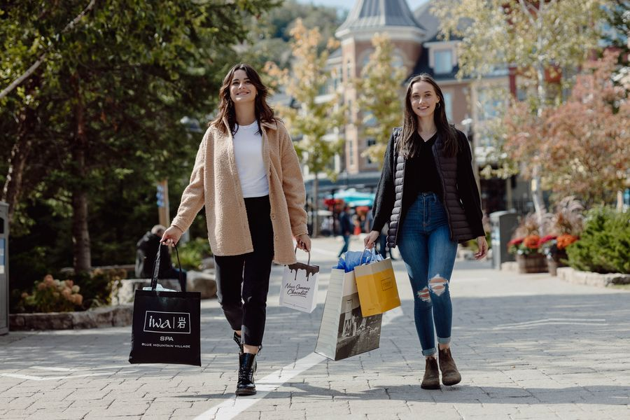
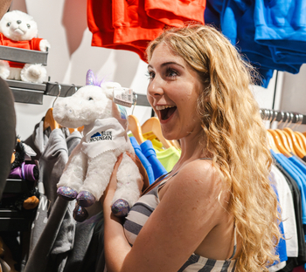
Blue Mountain Village
DINING & SHOPPING DISTRICT
From sunny cafés to vibrant patio hangouts and chef-inspired dining, Blue Mountain Village serves up over 30 establishments offering flavours for every appetite. Discover fresh seasonal menus, signature cocktails, and open-air patios throughout the Village.
Charming boutiques, artisanal shops, and cozy cafés line every street. Discover a perfect blend of local craftsmanship and popular brands, all set against a stunning mountain backdrop.

Slide 14
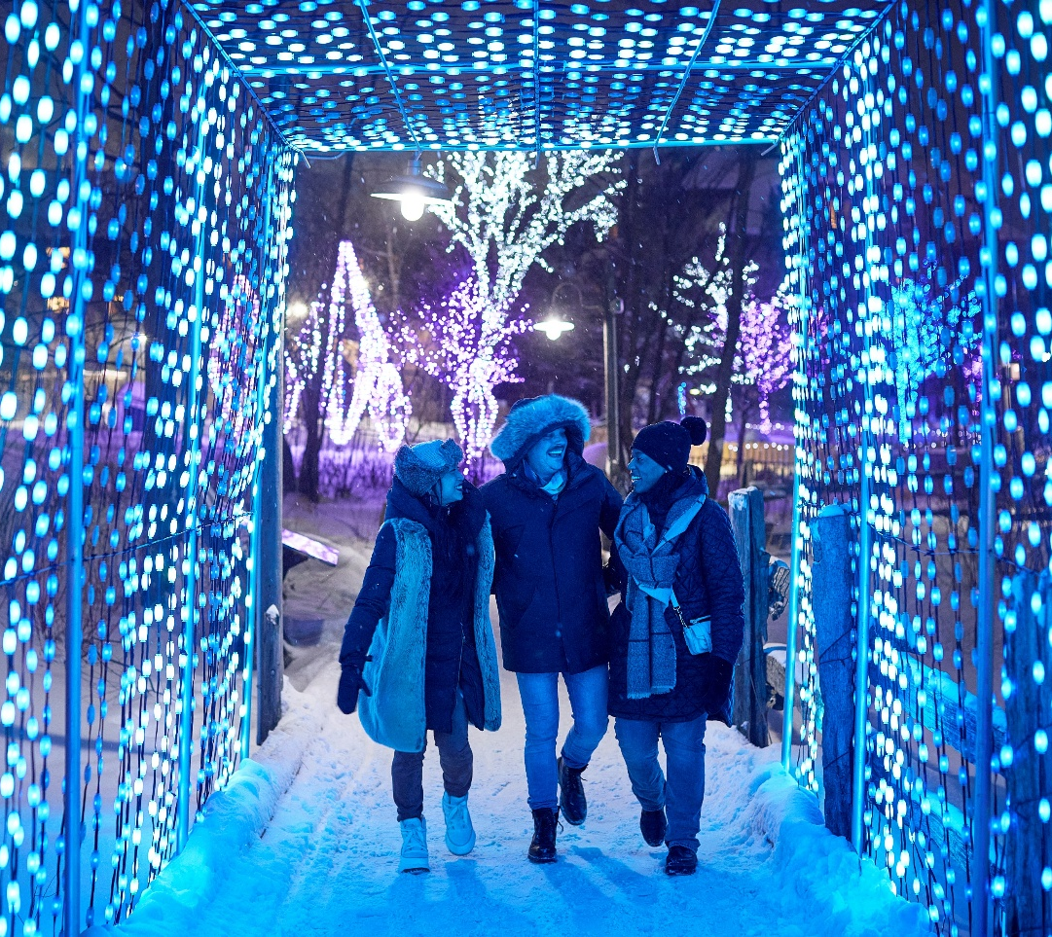
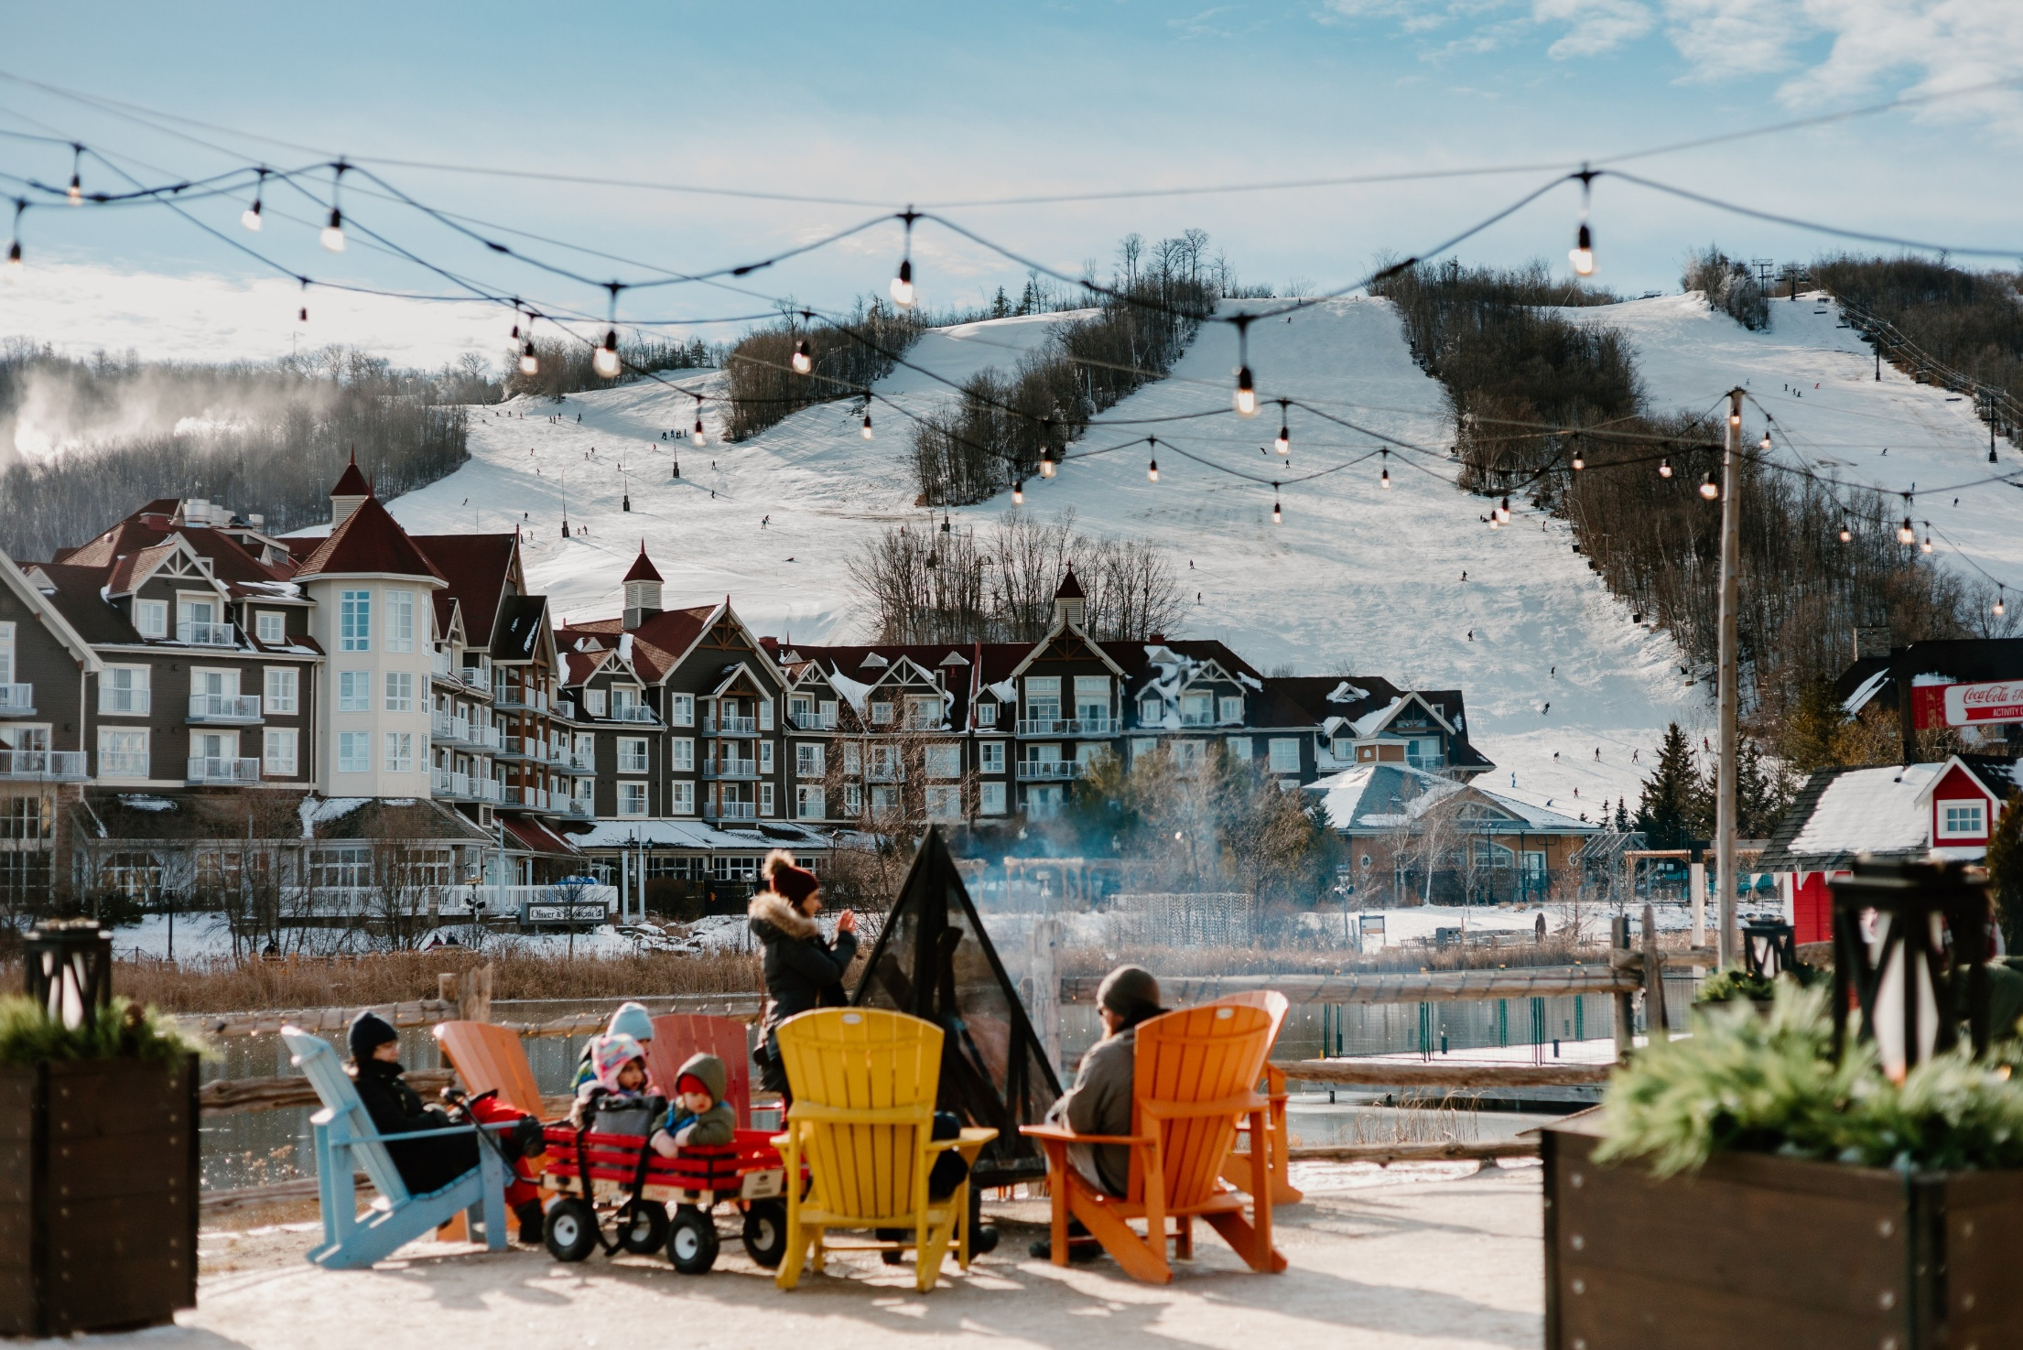
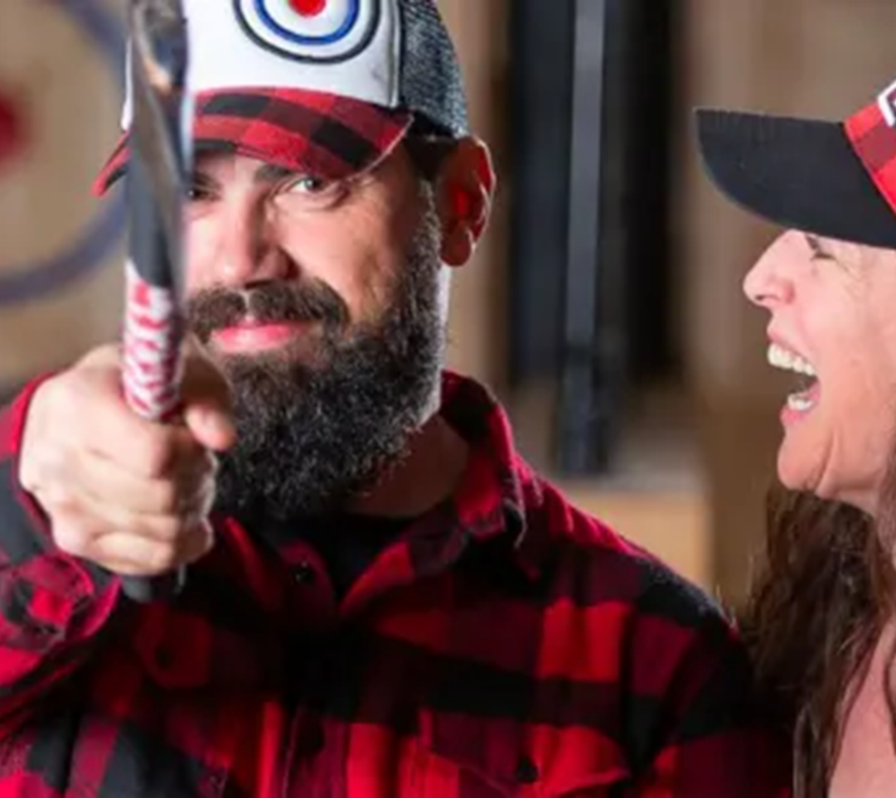
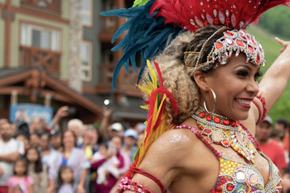
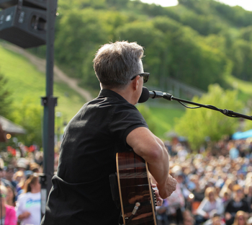
Blue Mountain Village
SEASONS OF EVENTS & ACTIVITIES
No matter the season, there’s always something happening in the Village!
Festivals, live music, sporting events and family activities are all part of the Village experience.
Blue Mountain Film & Media Festival
Salsa at Blue
Gone Country, Reggae on the Mountain, Rock Fest, Guitar Trail and Stomp the Mountain Music Festivals
24HR Blue Mountain Festival
Summit 700, Blue Bully, Spartan Races
Famarama, Canada Day and Apple Harvest Family Weekends
And more!

Slide 15
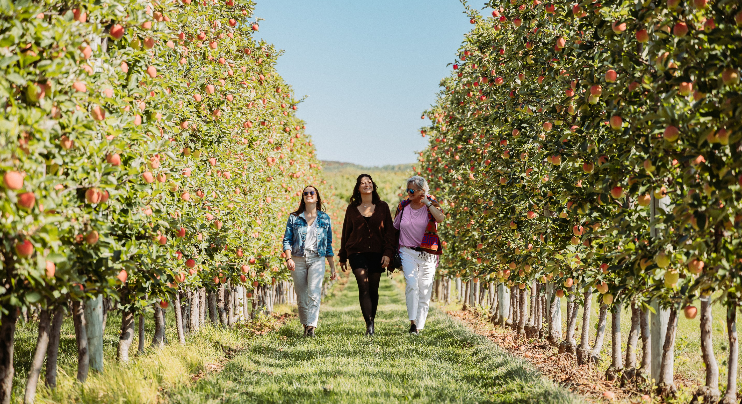
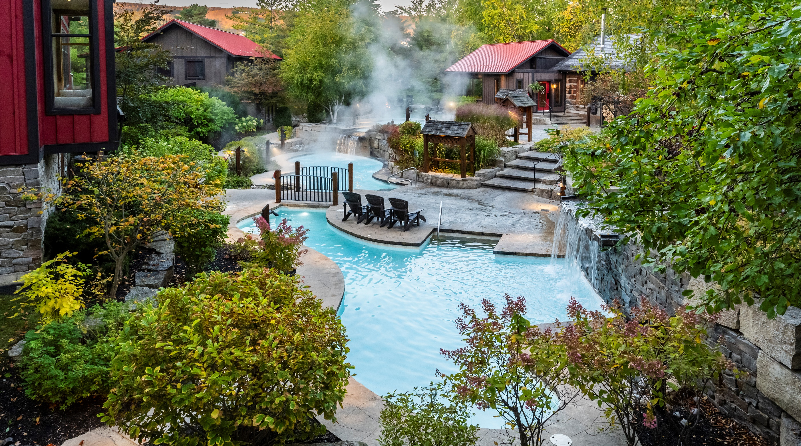
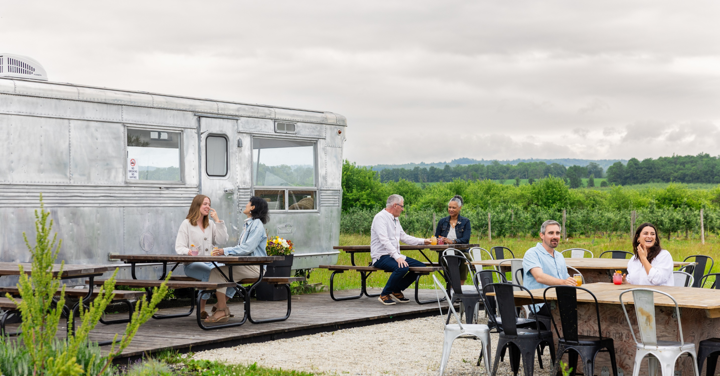
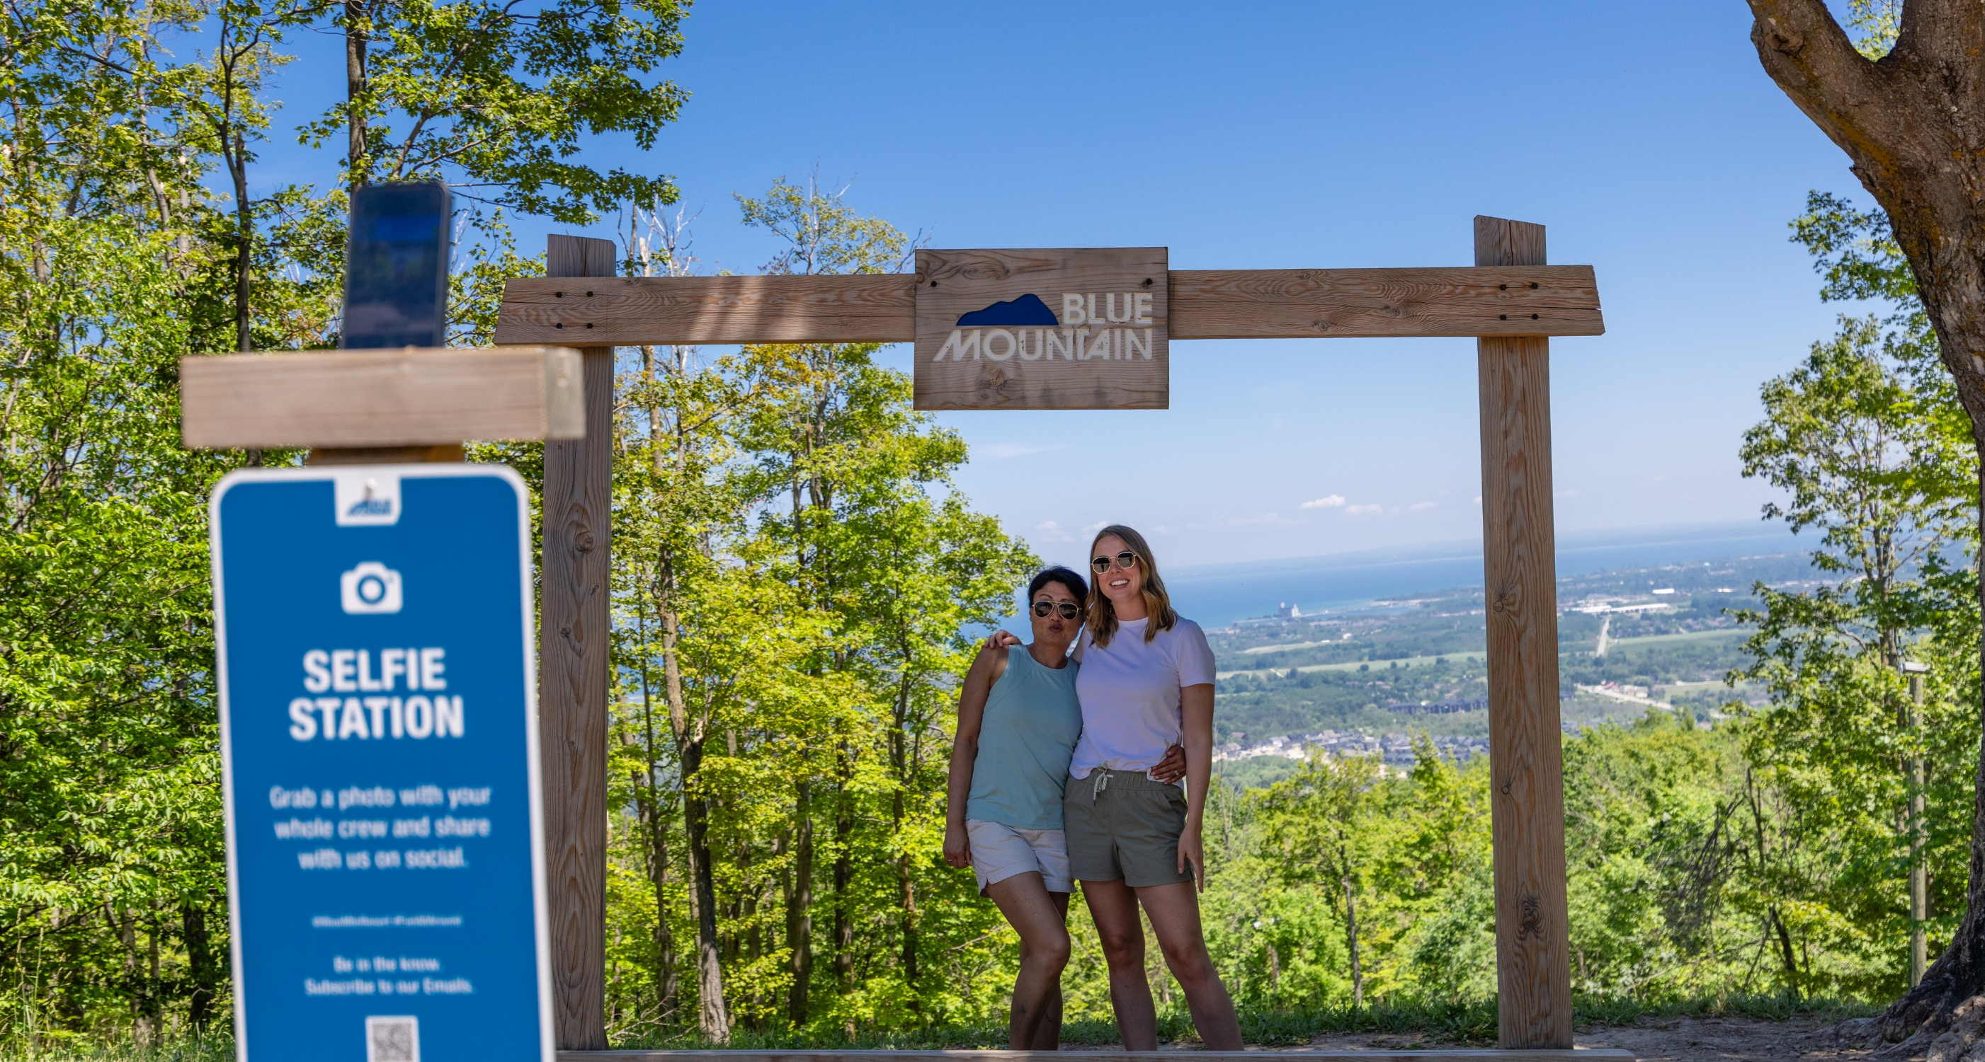

Slide 16
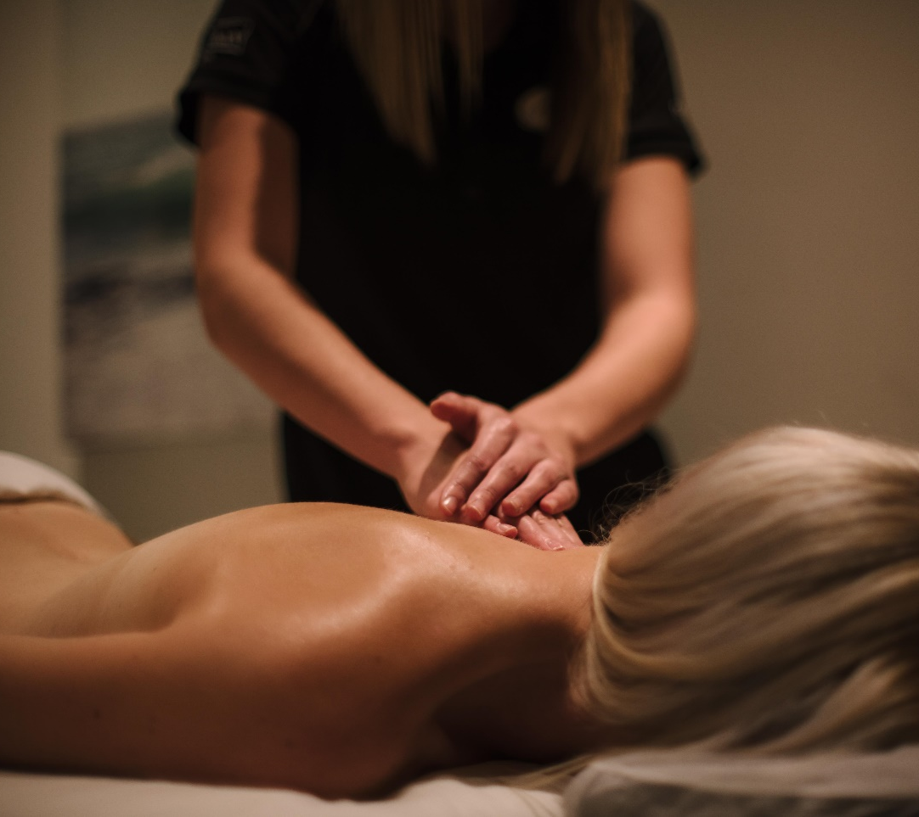
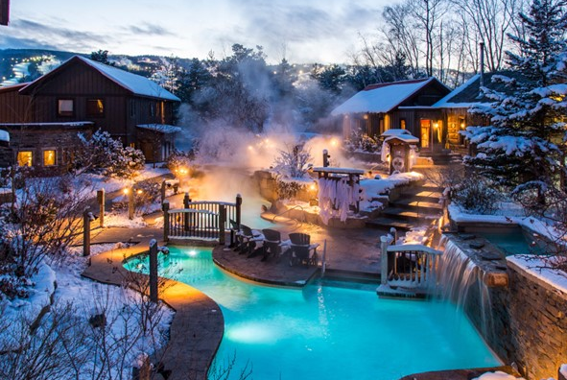



Award Winning Spas
SCANDINAVE SPA Blue Mountain offers a unique Scandinavian thermal journey year-round.
IWA SPA in the Blue Mountain Village provides volcanic hot rock experience, yoga and massage.

Slide 17





Signature Regional
Experiences
SCENIC CAVES NATURE PRESERVE
Enjoy year-round exploration on our network of trails and along Ontario’s longest suspension bridge, and in the warm seasons through our caves and crevices, among the treetops, across our ziplines and more. Choose your adventure and prepare for
awe-inspiring views at a variety of attractions.

Slide 18





Award Winning
APPLE PIE TRAIL &
CRAFT BEVERAGES
Taste your way through The Valley’s rich agricultural history. The legendary Apple Pie Trail links local orchards, bakeries, cideries, and restaurants to showcase our world-class apple heritage.

Slide 19





Slide 20

Resort Accommodation
With over 900 different accommodation units on the resort there are plenty of options ranging from classic hotel rooms to modern suites of Mosaic or The Westin Trillium House, Blue Mountain.

Slide 21






Blue Mountain Inn
98 Resort Rooms
        84 Double Beds
7 King Beds
1 Suite
4 Accessible Rooms
The Pottery Alpine Restaurant
Jozo’s Bar
Year-round Indoor Pool & Hot Tub
Outdoor Courtyard with Year-round Hot Tubs

Slide 22






Village Suites
600 Total Suites
66 Studio
119 Bachelor
275 One-Bedroom Suites
138 Two-Bedroom Suites
17 Three-Bedroom Suites
4 Accessible rooms
Kitchenettes in Studio Suites
Full Kitchens in Bachelors and Larger
Seasonal Outdoor Pools
Year-round Hot Tubs

Slide 23







The Westin Trillium House, Blue Mountain
A full-service four-diamond resort hotel at the base of Blue Mountain and featuring an exquisite dining experience at the renowned Oliver & Bonacini Café & Grill. The Westin Trillium House offers guest rooms and suites each featuring the luxurious Westin Heavenly Bed®, Heavenly Bath®, kitchenettes or full kitchen and gas fireplaces. Outdoor pool and hot tubs available year-round.

Slide 24

CHRIS HUYCKE
Manager, Tour Sales
Blue Mountain Resorts LP
P: 01.705.720.4442
chuycke@bluemountain.ca
MATT MCFARLANE
Marketing Specialist, Destination
Explore Blue / Blue Mountain Village Association
P: 01.705.444.7398
mmcfarlane@bluemountainvillage.ca

